Slide 1
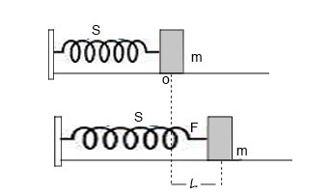
Oscillation of the loaded spring:
(a) Vibration of particle in horizontal spring
(b) Vibration of particle in vertical spring
(a) Vibration of particle in horizontal spring

Slide 2
Suppose the spring S is attached to the rigid support at one end and the mass m is attached to other end as in fig.
If the mass m is pulled horizontally and released then this mass will oscillate simple harmonically .
Let the displacement of mass from mean position is L. Due to extension of spring, there is a restoring force F set up on the spring which try to pull spring to its original position.
Then, according to Hook’s law, the restoring force is directly proportional to extension produced. So ,
…………….(i)
Here, k is called the force constant of spring or force per unit extension. The negative sign indicated that the restoring force acts opposite to the displacement of mass or extension produced.

Slide 3
Now, if ‘a’ be the acceleration produced on the system due to restoring force, then
………….(ii)
So, from eq. (i) & (ii), we get,
Or,
……………….(iii)
From (iii), we see that acceleration is directly proportional to displacement and is directed towards the mean position, therefore motion of spring in horizontal plane is Simple harmonic in nature
Now,
For simple harmonic motion, we have,
………………(iv)
Where, y is displacement of particle from mean position.
Comparing (iii) & (iv), we get,

Slide 4
Comparing (iii) & (iv), we get,
………….(v)
We know, time period of oscillation is,
……………(vi)
This gives the time period of oscillation for horizontal spring mass system. From (vi), we can see that time period of oscillation depends on the mass attached to spring.

Slide 5
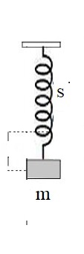
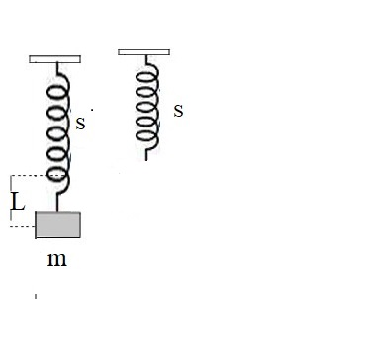
(b) Vibration of particle in vertical spring
(2)
(1)
(3)
F₁
y
F₂
Fig: mass oscillation in the vertical spring.

Slide 6
Suppose the spring is fixed vertically as in fig and mass m is attached to lower end so that force due to mass produces the extension ‘L’ on the spring as in fig.
In this case, the restoring force F₁ is given by Hook’s law as,
……………..(i)
If the load is pulled down by small displacement y, then the restoring force F₂ is given by,
…………………(ii)
Now, the net effective restoring force that is responsible for oscillation of system is given by,
………………(iii)

Slide 7
If a be the acceleration produced in the spring system, then we can write,
……………..(iv)
Since, acceleration is directly proportional to the displacement and is directed towards the mean position, the motion here is also the simple harmonic.
Now,
For SHM, we have,
……………(v)

Slide 8
Comparing (iv) & (v), we get,
We know, time period of oscillation is,
……………(vi)
This gives the time period of oscillation for vertical spring mass system. From (vi), we can see that time period of oscillation depends on the mass attached to spring.

Slide 9
Therefore, the time period of oscillation for spring mass system depends upon,
(i) Mass of the object attached to the spring.
(ii) Spring constant k of the spring.
(iii) But it doesn’t depend on the acceleration due to gravity.

Slide 10
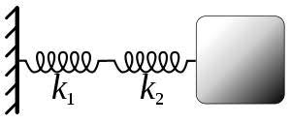
Combination of the spring:
For the combination of the spring, if Keff be the effective spring constant for the combination, then, time period in this situation is given by,
Now, we will discuss about the series and parallel combination of the spring:
Series combination of the spring: When springs are connected in the series,
(a) Force acting on each springs are same.
(b) Total extension produced on all springs are given by sum of extension on each spring i.e.

Slide 11
We know,
So, total extension,
------------(i)
This equation (i) gives effective spring constant when the springs are connected in series.
Time period in series combination is given by,

Slide 12
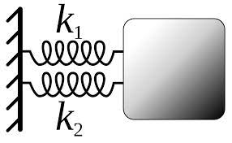
(ii) Parallel combination of the springs: When springs are connected in parallel combination then, following thing happens,
Different force acts on different springs so that total force is given by the sum of force on each springs,
Extension on each spring is same. So,
------------(ii)
This gives effective spring constant in case of the parallel combination of the springs.
Time period:

Slide 13
Angular simple harmonic motion: (Torsinal pendulum)
Definition: It is defined as the oscillatory motion of a body in which the torque (τ) or angular acceleration (α) is directly proportional to the angular displacement (θ) and its direction is opposite to that of the angular displacement.
The oscillation of torsinal pendulum is example of angular SHM.

Slide 14
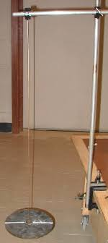
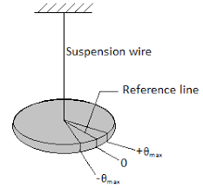
The torsinal pendulum consist of the disc suspended by the wire such that when disc is displaced from mean position by twisting it horizontally and then released the system as a whole starts to oscillate in horizontal plane about mean position represented by reference line in fig.
Fig: torsional pendulum

Slide 15
Let the system oscillate with the maximum displacement θ_{m} . Here, for any angular displacement θ, there is the restoring torque acting on disc which is responsible for oscillation in horizontal plane. This restoring torque is directly proportional to the angular displacement θ .
So,
……………(i)
Where, k is the proportionality constant called torsional constant which depends on the dimension and material of the suspension wire.

Slide 16
The torsional constant k can be defined as the torque per unit angular displacement.
Negative sign indicates that τ is acting opposite to θ.
If I be the moment of inertia of the body and α be the angular acceleration, then,
………………(ii)
Then, from (i) and (ii), we get,
……………….(iii)

Slide 17
But for angular SHM,
……………….(iv)
So, comparing with (iii), we get,
……………….(v)
This gives the angular velocity of the system.
From the equation (iii) we can see that the angular acceleration is proportional to the angular displacement and is directed towards the mean position. Therefore the motion of torsional pendulum is angular SHM in nature.

Slide 18
Time period: Time period for this system is given by,
Then frequency is given as,
Where, I is the moment of inertia for the disc.

Slide 19
Energy in the SHM:
During the SHM, the particle will have both K.E. and P.E.
The K.E. is due to the motion of particle and P.E. is due to displacement from mean position.
During the entire motion, K.E and P.E. changes continuously as velocity and position of particle changes continuously.
But at any instant, the total energy will always remain constant.

Slide 20
(a) Kinetic energy: for any particle moving with the velocity ‘v’, the K.E. is given by,
For SHM,
So, K.E. of particle executing SHM is,

Slide 21
(b) Potential energy: suppose the particle having mass ‘m’ is executing SHM with angular velocity ω and let its displacement is x from mean position. Then restoring force on the particle is,
Now, small amount of the work done in moving particle through small distance dx against force is,

Slide 22
Therefore, total amount of workdone in moving particle from mean position (y=0) to displacement y is,
This amount of workdone is stored as the potential energy in the system. Therefore,

Slide 23
Now, the total energy of the SHM is given by the sum of K.E. and P.E. as,
As we know,
So, we have,
Since, m, ω and r constant for particle executing SHM, the total energy is always constant.

Slide 24
Case-1: When particle is at mean position, y=0. so,
And ,
So total energy here is equal to the maximum value of kinetic energy.

Slide 25
Case-ii: When particle is at extreme position, y=r. so,
Therefore, total energy is equal to maximum value of P.E.

Slide 26
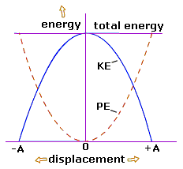

Slide 27
Explanation of the graph:
The nature of the graph for the variation of kinetic and potential energy as a function of displacement from mean position is shown in the fig in previous slide.
From the graph, we can see that the K.E. at mean position has max value and on moving from mean position, its value goes on decreasing and finally becomes zero for position of maximum displacement i.e. at y=r.

Slide 28
Similarly, the P.E. at mean position is always zero but as the displacement of particle from mean position increases, the P.E. goes on increasing and it becomes max at the position of max displacement i.e. at y=r, P.E.=maximum.
But at all position, the total energy is always constant which is given by sum of kinetic and potential energy.

Slide 29
Oscillatory motion:
There are mainly three types of the oscillatory motion in nature:
Damped oscillation
Free oscillation
Forced oscillation
(i) Damped oscillation: There are different kinds of dissipative forces acting on the oscillatory motion which are responsible for energy loss during motion of system. Examples of such forces are frictional force, viscous force etc and these forces offer resistance to the motion. Due to these forces, there is gradual decrease in energy of the motion so that system vibrates with gradually decreasing amplitude and it finally comes to rest . Such motion are called the damped oscillation.

Slide 30
(ii)Free oscillation: when any system is displaced from the mean position by certain initial energy and then released then it starts to oscillate freely with natural frequency and with constant amplitude. This type of motion in which there are no any energy dissipating forces acting on the system so that body oscillate with its natural frequency is called the free oscillation.
(iii) Forced oscillation: If the body is set into oscillatory motion by the constant periodic force having frequency other than natural frequency of oscillation then such type of motion are called the forced oscillation.
During forced oscillation of the body, if the frequency of the applied periodic force matches with the natural frequency of the oscillation of that body, then at that condition, the body starts to oscillate with maximum amplitude and this phenomenon is called the resonance. This is the special case of forced vibration.

